Slide 2
WARM UP!
GOOD MORNING EVERYBODY!
ARE YOU READY?

Slide 3
WHAT IS YOUR NAME?

Slide 4
DO YOU LIKE CHOCOLATE EGGS?

Slide 5
HAVE YOU GOT A PET?

Slide 6
WHAT IS YOUR PET'S NAME?

Slide 7
HAVE YOU GOT SIBLINGS?

Slide 8
HOW OLD ARE YOU?

Slide 9
HOW ARE YOU FEELING TODAY?

Slide 10
WHAT ARE YOU WEARING TODAY?

Slide 11
DO YOU LIKE SPIDERS?

Slide 12
CAN YOU SEE YOUR SCHOOL?
No, I can not. No I can't

Slide 13
ARE YOU A BOY OR A GIRL?

Slide 14
WHERE DO YOU LIVE?

Slide 15
DO YOU SPEAK CZECH?

Slide 16
DO YOU LIVE IN THE CZECH REPUBLIC?

Slide 17
DO YOU SLEEP IN YOUR BED?

Slide 18
Co mají tyhle otázky společné?
DO YOU SPEAK CZECH?
DO YOU LIVE IN THE CZECH REPUBLIC?
DO YOU SLEEP IN YOUR BED?

Slide 19
NÁPOVĚDA
DO YOU SPEAK CZECH?
DO YOU LIVE IN THE CZECH REPUBLIC?
DO YOU SLEEP IN YOUR BED?

Slide 20
PRESENT SIMPLE – přítomný čas
DO YOU SPEAK CZECH?
DO YOU LIVE IN THE CZECH REPUBLIC?
DO YOU SLEEP IN YOUR BED?

Slide 21
Odpověď
DO YOU SPEAK CZECH?
DO YOU LIVE IN THE CZECH REPUBLIC?
DO YOU SLEEP IN YOUR BED?
Yes, I do.
No, I don't.

Slide 22
Odpověď
DO YOU SPEAK CZECH?
I speak Czech.
DO YOU LIVE IN THE CZECH REPUBLIC?
I live in the Czech republic.
DO YOU SLEEP IN YOUR BED?
I sleep in my bed.

Slide 23
Zápor
DO YOU SPEAK CZECH?
I speak Czech.
DO YOU LIVE IN THE CZECH REPUBLIC?
I live in the Czech republic.
DO YOU SLEEP IN YOUR BED?
I sleep in my bed.

Slide 24
Zápor
DO YOU SPEAK CZECH?
I don't speak Czech.
DO YOU LIVE IN THE CZECH REPUBLIC?
I don't live in the Czech republic.
DO YOU SLEEP IN YOUR BED?
I don't sleep in my bed.

Slide 25
3. osoba
Pomocné sloveso?
Zápor?

Slide 26
Does she like apples?
Yes, she does.
No, she doesn't.

Slide 28
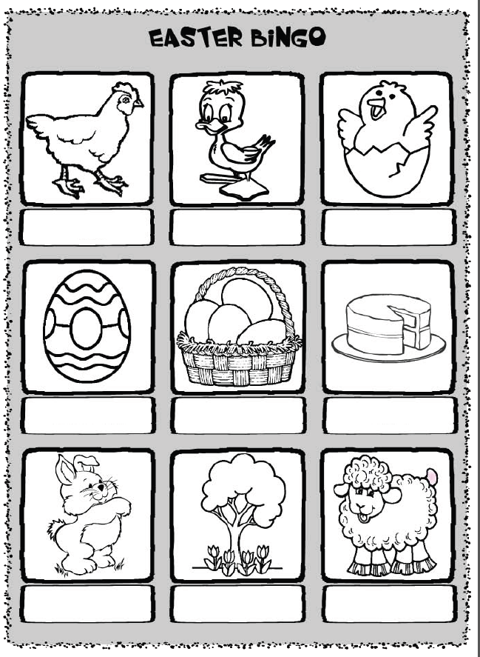

Slide 29
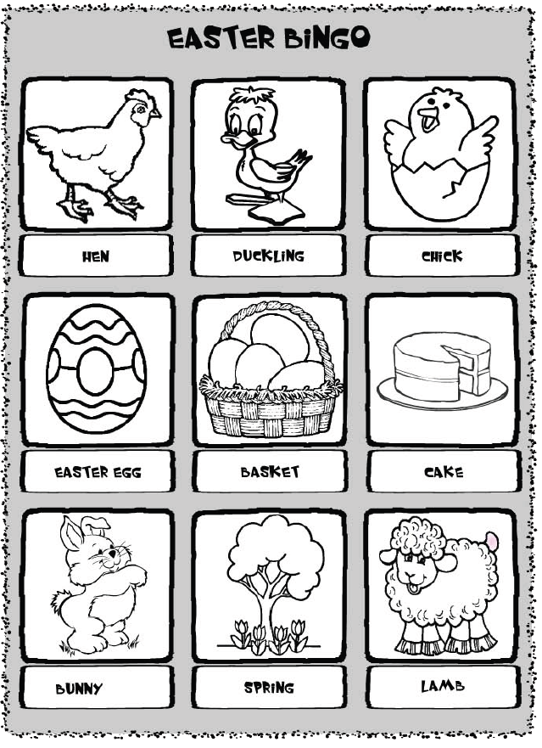

Slide 30
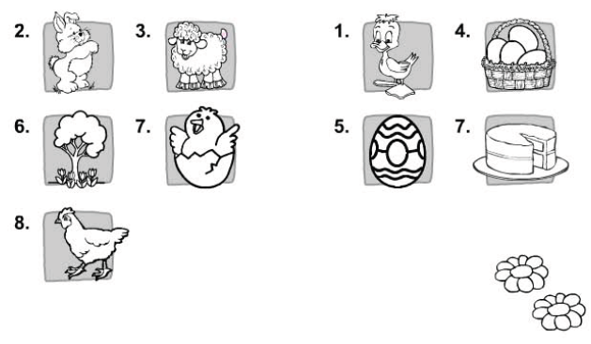

Slide 31
gegs
What is this?

Slide 32
What is this?
igprns

Slide 33
What is this?
ktaseb

Slide 34
What is this?
nyubn

Slide 35
What is this?
abml

Slide 36
What is this?
cnehkic

Slide 37
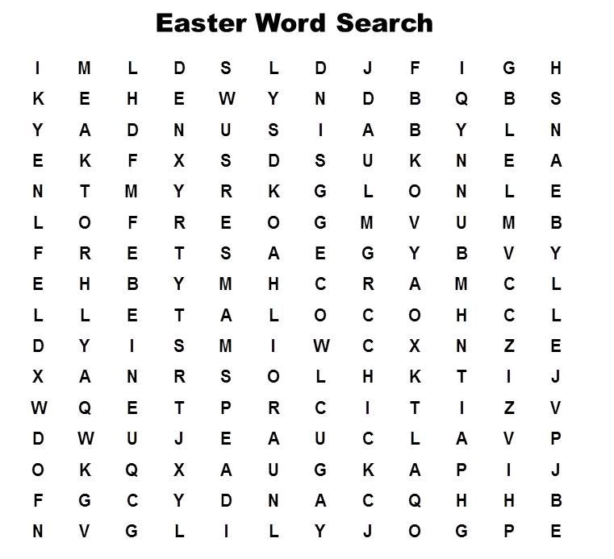

Slide 38
